Slide 1
The Second Law of Thermodynamics

Slide 2
In the previous lectures, we applied the first law of thermodynamics, or the conservation of energy principle, to processes involving closed and open systems.
As pointed out repeatedly in those lectures, energy is a conserved property, and no process is known to have taken place in violation of the first law of thermodynamics.
Therefore, it is reasonable to conclude that a process must satisfy the first law to occur.
However, satisfying the first law alone does not ensure that the process will actually take place.

Slide 3
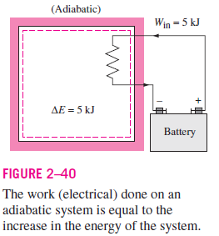
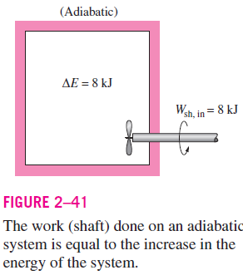
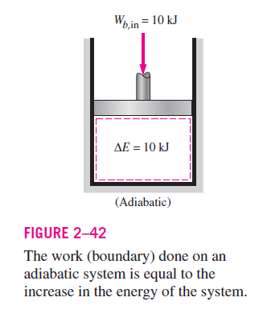

Slide 4
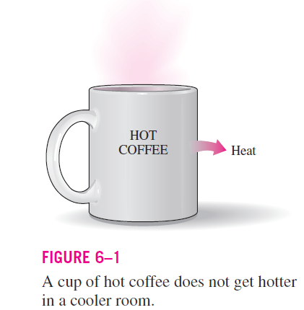
It is common experience that a cup of hot coffee left in a cooler room eventually cools off (Fig. 6–1).
This process satisfies the first law of thermodynamics since the amount of energy lost by the coffee is equal to the amount gained by the surrounding air.
Now let us consider the reverse process—the hot coffee getting even hotter in a cooler room as a result of heat transfer from the room air.
We all know that this process never takes place.
Yet, doing so would not violate the first law as long as the amount of energy lost by the air is equal to the amount gained by the coffee.

Slide 5
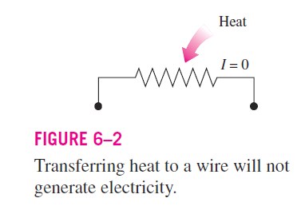
As another familiar example, consider the heating of a room by the passage of electric current through a resistor (Fig. 6–2).
Again, the first law dictates that the amount of electric energy supplied to the resistance wires be equal to the amount of energy transferred to the room air as heat.
Now let us attempt to reverse this process. It will come as no surprise that transferring some heat to the wires does not cause an equivalent amount of electric energy to be generated in the wires.

Slide 6
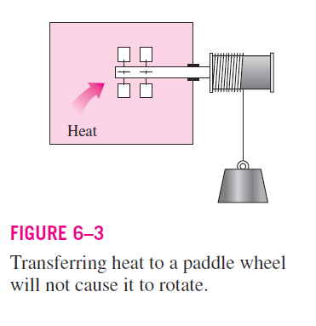
Finally, consider a paddle-wheel mechanism that is operated by the fall of a mass (Fig. 6–3).
The paddle wheel rotates as the mass falls and stirs a fluid within an insulated container.
As a result, the potential energy of the mass decreases, and the internal energy of the fluid increases in accordance with the conservation of energy principle.
However, the reverse process, raising the mass by transferring heat from the fluid to the paddle wheel, does not occur in nature, although doing so would not violate the first law of thermodynamics.

Slide 7
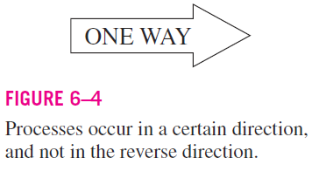
It is clear from these arguments that processes proceed in a certain direction and not in the reverse direction (Fig. 6–4).
The first law places no restriction on the direction of a process but satisfying the first law does not ensure that the process can actually occur.

Slide 8
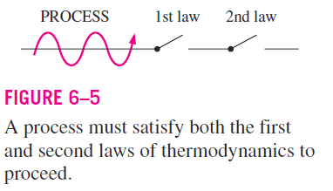
This inadequacy of the first law to identify whether a process can take place is remedied by introducing another general principle, the second law of thermodynamics.
The reverse processes discussed above violate the second law of thermodynamics.
A process cannot occur unless it satisfies both the first and the second laws of thermodynamics (Fig. 6–5).

Slide 9
The Second Law of Thermodynamics
There are many ways to state the second law; :
“Heat can flow spontaneously from a hot object to a cold object; it will not flow spontaneously from a cold object to a hot object.”
Kelvin–Planck Statement
“It is impossible by a cyclic process to convert the heat absorbed by a system completely into work done by the system. “
Or
It is impossible for any device that operates on a cycle to receive heat from a single reservoir and produce a net amount of work.

Slide 10
The use of the second law of thermodynamics is not limited to identifying the direction of processes, however.
The second law also asserts that energy has quality as well as quantity.
More of high-temperature energy can be converted to work, and thus it has a higher quality than the same amount of energy at a lower temperature.
The first law is concerned with the quantity of energy and the transformations of energy from one form to another with no regard to its quality.
Preserving the quality of energy is a major concern to engineers, and the second law provides the necessary means to determine the quality as well as the degree of degradation of energy during a process.

Slide 11
Heat transfer from industrial sources to the environment is of major concern to environmentalists as well as to engineers.
Irresponsible management of waste energy can significantly increase the temperature of portions of the environment, causing what is called thermal pollution.
If it is not carefully controlled, thermal pollution can seriously disrupt marine life in lakes and rivers.

Slide 12
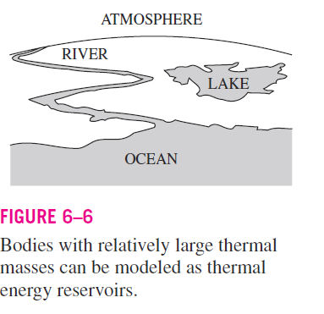

THERMAL ENERGY RESERVOIRS
In the development of the second law of thermodynamics, it is very convenient to have a hypothetical body with a relatively large thermal energy capacity (mass x specific heat) that can supply or absorb finite amounts of heat without undergoing any change in temperature. Such a body is called a thermal energy reservoir, or just a reservoir.
In practice, large bodies of water such as oceans, lakes, and rivers as well as the atmospheric air can be modeled accurately as thermal energy reservoirs because of their large thermal energy storage capabilities or thermal masses (Fig. 6–6).

Slide 13
The atmosphere, for example, does not warm up as a result of heat losses from residential buildings in winter.
Likewise, megajoules of waste energy dumped in large rivers by power plants do not cause any significant change in water temperature.
A body does not actually have to be very large to be considered a reservoir.
Any physical body whose thermal energy capacity is large relative to the amount of energy it supplies or absorbs can be modeled as reservoir.
The air in a room, for example, can be treated as a reservoir in the analysis of the heat dissipation from a TV set in the room,
Since the amount of heat transfer from the TV set to the room air is not large enough to have a noticeable effect on the room air temperature.

Slide 14
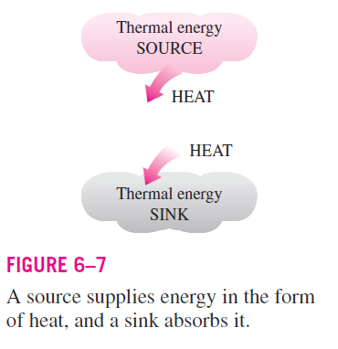
A reservoir that supplies energy in the form of heat is called a source,
And one that absorbs energy in the form of heat is called a sink (Fig. 6–7).
Thermal energy reservoirs are often referred to as heat reservoirs since they supply or absorb energy in the form of heat.

Slide 15
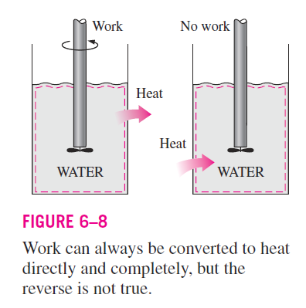
HEAT ENGINES
As pointed out earlier, work can easily be converted to other forms of energy, but converting other forms of energy to work is not that easy.
The mechanical work done by the shaft shown in Fig. 6–8, for example, is first converted to the internal energy of the water. This energy may then leave the water as heat.
We know from experience that any attempt to reverse this process will fail. That is, transferring heat to the water does not cause the shaft to rotate.
From this and other observations, we conclude that work can be converted to heat directly and completely, but converting heat to work requires the use of some special devices. These devices are called heat engine

Slide 16
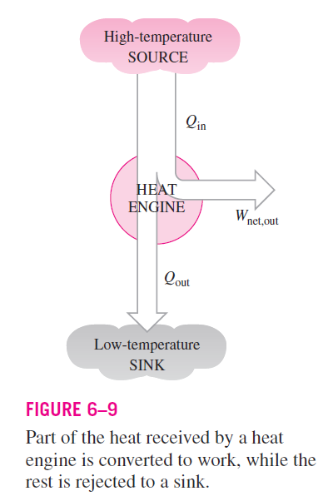
Heat engine is device which converts heat energy into mechanical work
Heat engines differ considerably from one another, but all can be characterized by the following (Fig. 6–9):
They receive heat from a high-temperature source (solar energy, oil furnace, nuclear reactor, etc.).
They convert part of this heat to work (usually in the form of a rotating shaft).
They reject the remaining waste heat to a low-temperature sink (the atmosphere, rivers, etc.).
They operate on a cycle.
Heat engines and other cyclic devices usually involve a fluid to and from which heat is transferred while undergoing a cycle. This fluid is called the working fluid.
Notes:
The working fluid of a heat engine or heat pump is a gas or liquid, usually called a refrigerant, coolant, or working gas, that primarily converts thermal energy (temperature change) into mechanical energy (or vice versa) by phase change and/or heat of compression and expansion

Slide 17
Internal Combustion Engines
An internal combustion (IC) engine is a heat engine in which the combustion of a fuel takes place with an oxidizer (usually air) inside the combustion chamber.
For example: Petrol engines, Diesel engines and Gas engines
In an IC engine, the expansion of the high-temperature and high-pressure gases produced by combustion applies direct force to some component of the engine.
The force is applied typically to pistons, turbine blades, rotor or a nozzle.
This force moves the component over a distance, transforming chemical energy into useful mechanical energy.

Slide 18
Classification of Internal Combustion Engines
The IC engine can be classified in many ways; but the following are important from the subject point of view:
According to the type of fuel:
Petrol engine
Gas Engine
Heavy oil engine or diesel engine
According to the method of ignition of fuel:
Spark ignition engine
Compression ignition engine
According to the cycle of operation:
Four stroke cycle engine
Two stroke cycle engine
According to the process of combustion:
Otto cycle engine
Diesel cycle engine
Dual combustion engine

Slide 19
According to the speed of engine:
Slow speed engine
Medium speed engine
High speed engine
According to the cooling system:
Air cooled engine
Water cooled engine
Evaporative cooling engine
According to the method of fuel injection:
Carburetor engine
Air injection engine
Airless or solid injection engine
According to the arrangement of cylinder:
Vertical engine
Horizontal engine
Radial engine

Slide 20
External Combustion Engines
An external combustion engine is a heat engine in which the combustion of a fuel takes place outside the cylinder.
For example: Steam engines
In steam engines the fuel, fed into the cylinder, is in the form of steam which is already heated (or superheated) and is ready for working in the cycle of engines.
External combustion engines are no longer used in transportation, as mobile designs are not efficient enough, but they continue to be used in power plants.
For example, a natural gas power plant boils water into steam to turn a turbine, creating electricity.

Slide 21
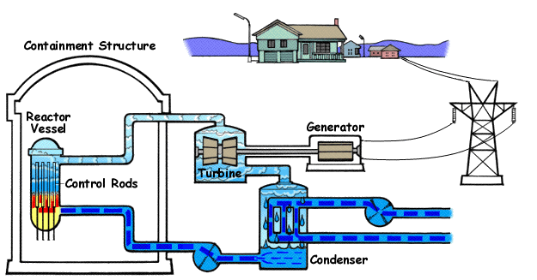

Slide 22
Comparison
Steam engines
Fuel is burnt outside the engine cylinder
Working pressure and temperature inside the engine cylinder is low
Because of low pressure and temperature ordinary alloys are used for the manufacture of cylinder and its parts
A steam engine requires a boiler and other components to transfer the energy, thus it is heavy and cumbersome
The steam engine have efficiency about 15-20%
It can not be started instantaneously
IC engines
Fuel is burnt inside the engine cylinder
Working pressure and temperature inside the engine cylinder is high
Because of high pressure and temperature special alloys are used for the manufacture of cylinder and its parts
An IC engine does not require a boiler and other components to transfer the energy, thus it is light and compact
The IC engine have efficiency about 35-40%
It can be started instantaneously

Slide 23
The term heat engine is often used in a broader sense to include work producing devices that do not operate in a thermodynamic cycle.
Engines that involve internal combustion such as gas turbines and car engines fall into this category.
These devices operate in a mechanical cycle but not in a thermodynamic cycle since the working fluid (the combustion gases) does not undergo a complete cycle.
Instead of being cooled to the initial temperature, the exhaust gases are purged and replaced by fresh air-and-fuel mixture at the end of the cycle.

Slide 24
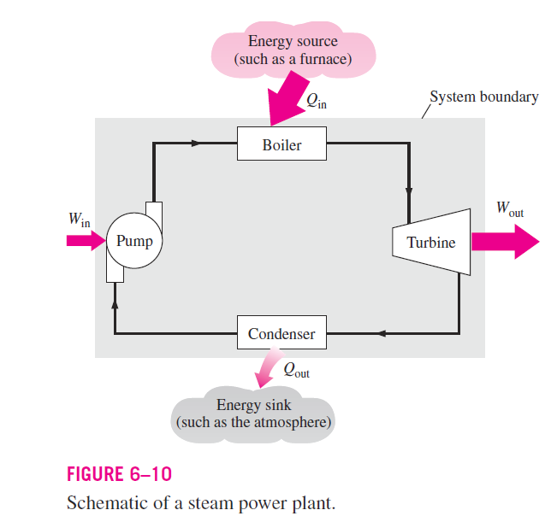
The work-producing device that best fits into the definition of a heat engine is the steam power plant, which is an external-combustion engine.
That is, combustion takes place outside the engine, and the thermal energy released during this process is transferred to the steam as heat.
The schematic of a basic steam power plant is shown in Fig. 6–10.

Slide 25
The various quantities shown on this figure are as follows:
Q_{in} amount of heat supplied to steam in boiler from a high-temperature source (furnace)
Q_{out} amount of heat rejected from steam in condenser to a low temperature sink (the atmosphere, a river, etc.)
W_{out} amount of work delivered by steam as it expands in turbine
W_{in} amount of work required to compress water to boiler pressure
Notice that the directions of the heat and work interactions are indicated by the subscripts in and out. Therefore, all four of the described quantities are always positive.

Slide 26
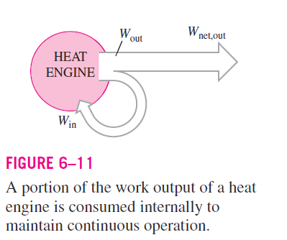
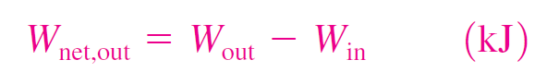
The net work output of this power plant is simply the difference between the total work output of the plant and the total work input (Fig. 6–11):
The four components of the steam power plant involve mass flow in and out, and therefore they should be treated as open systems.

Slide 27
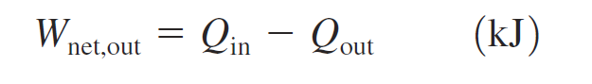
These components, together with the connecting pipes, however, always contain the same fluid (not counting the steam that may leak out, of course).
No mass enters or leaves this combination system, which is indicated by the shaded area on Fig. 6–10; thus, it can be analyzed as a closed system.
For a closed system undergoing a cycle, the change in internal energy U is zero, therefore the net work output of the system is also equal to the net heat transfer to the system:
Eq 6.2

Slide 28
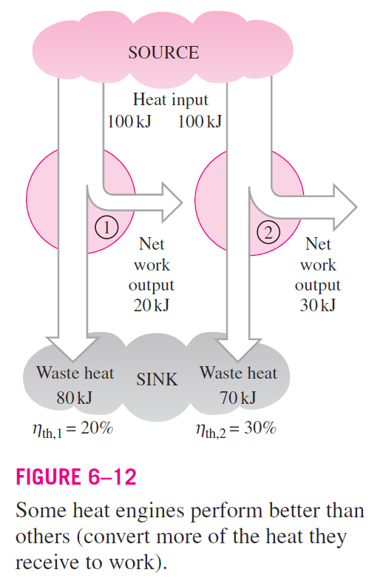
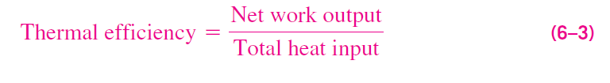
Thermal Efficiency
In Eq. 6.2, Q_{out} represents the magnitude of the energy wasted in order to complete the cycle.
But Q_{out} is never zero; thus, the net work output of a heat engine is always less than the amount of heat input.
That is, only part of the heat transferred to the heat engine is converted to work.
The fraction of the heat input that is converted to net work output is a measure of the performance of a heat engine and is called the thermal efficiency (ƞ_{th})
The thermal efficiency of a heat engine can be expressed as

Slide 29
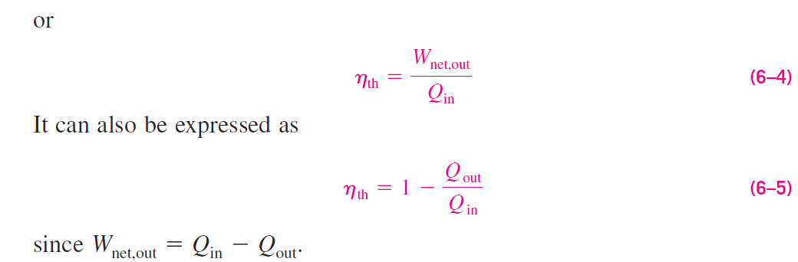

Slide 30
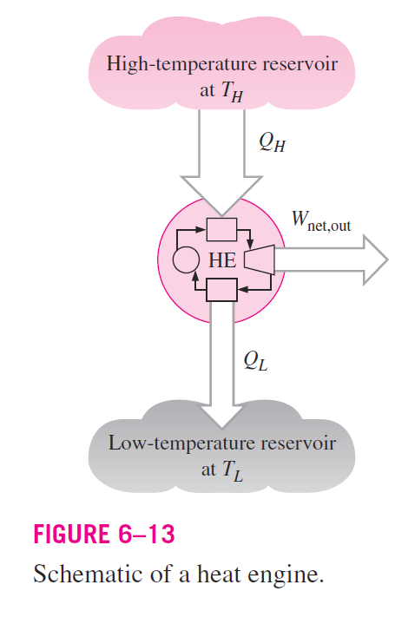
Cyclic devices of practical interest such as heat engines, refrigerators, and heat pumps operate between a high-temperature reservoir at temperature T_{H} and a low-temperature reservoir at temperature T_{L}.
To bring uniformity to the treatment of heat engines, refrigerators, and heat pumps, we define these two quantities:
Q_{H} magnitude of heat transfer between the cyclic device and the high temperature reservoir at temperature T_{H}
Q_{L} magnitude of heat transfer between the cyclic device and the low temperature reservoir at temperature T_{L}

Slide 31
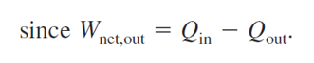
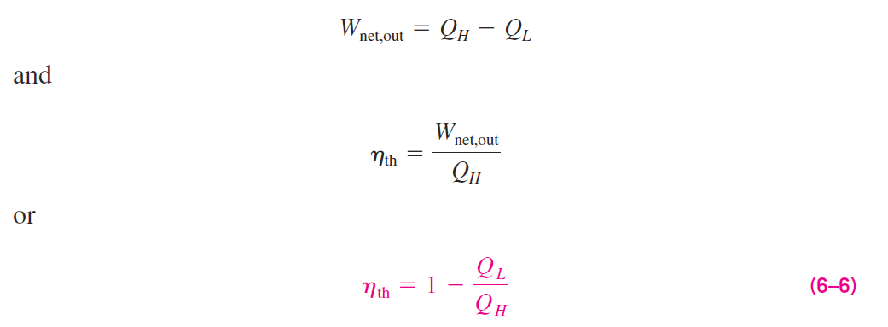
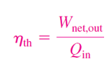
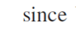
Notice that both Q_{L} and Q_{H} are defined as magnitudes and therefore are positive quantities.
The direction of Q_{H} and Q_{L} is easily determined by inspection.
Then the net work output and thermal efficiency relations for any heat engine (shown in Fig. 6–13) can also be expressed as

Slide 32
The thermal efficiency of a heat engine is always less than unity since both Q_{L} and Q_{H} are defined as positive quantities.
Thermal efficiency is a measure of how efficiently a heat engine converts the heat that it receives to work.
Heat engines are built for the purpose of converting heat to work, and engineers are constantly trying to improve the efficiencies of these devices since increased efficiency means less fuel consumption and thus lower fuel bills and less pollution.
The thermal efficiencies of work-producing devices are relatively low.
Ordinary spark-ignition automobile engines have a thermal efficiency of about 25 percent. That is, an automobile engine converts about 25 percent of the chemical energy of the gasoline to mechanical work.
This number is as high as 40 percent for diesel engines and large gas-turbine plants and as high as 60 percent for large combined gas-steam power plants.

Slide 33
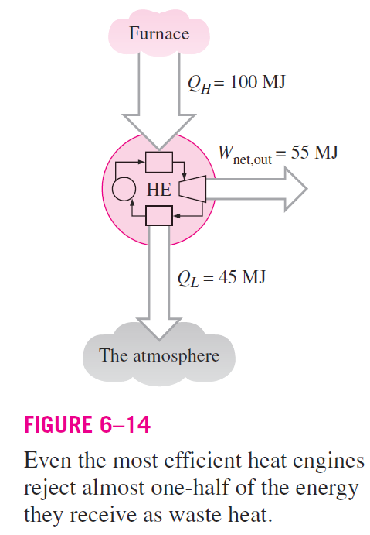
Thus, even with the most efficient heat engines available today, almost one-half of the energy supplied ends up in the rivers, lakes, or the atmosphere as waste or useless energy (Fig. 6–14).

Slide 34
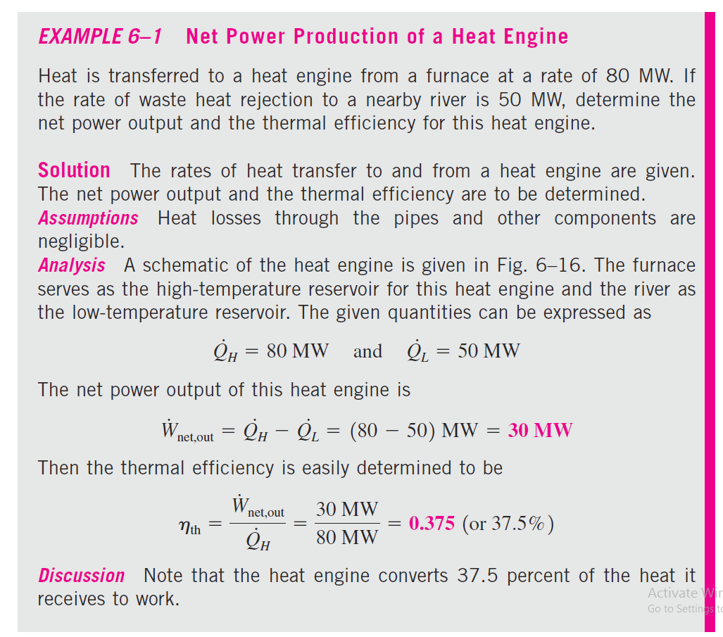
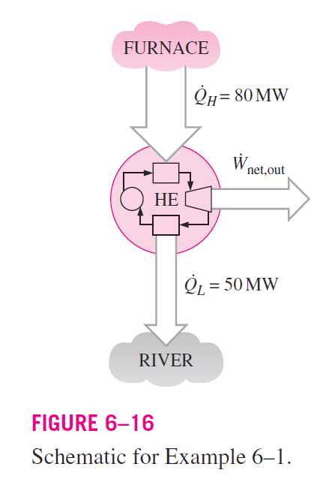

Slide 35
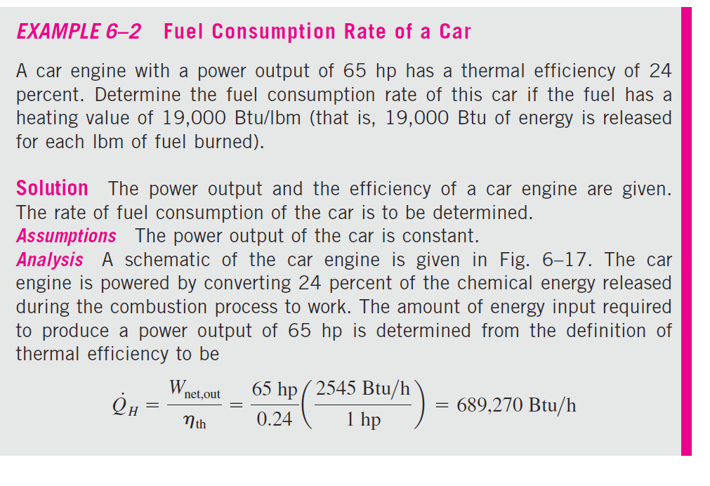
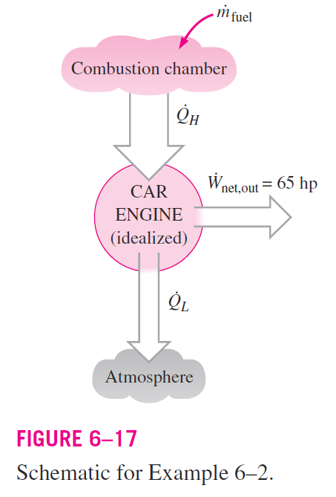
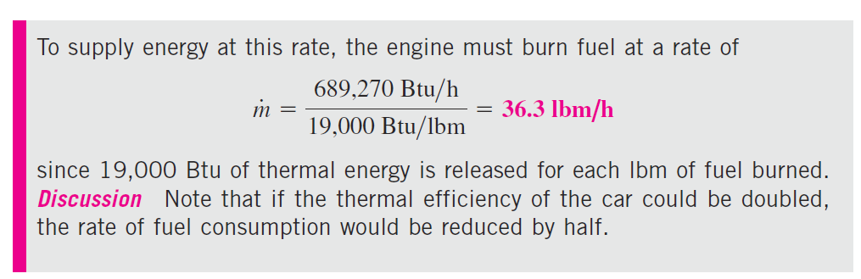

Slide 36
The Second Law of Thermodynamics: Kelvin–Planck Statement
We have demonstrated earlier with reference to the heat engine, even under ideal conditions, a heat engine must reject some heat to a low-temperature reservoir in order to complete the cycle.
That is, no heat engine can convert all the heat it receives to useful work.
This limitation on the thermal efficiency of heat engines forms the basis for the Kelvin–Planck statement of the second law of thermodynamics, which is expressed as follows:
“It is impossible for any device that operates on a cycle to receive heat from a single reservoir and produce a net amount of work.”

Slide 37
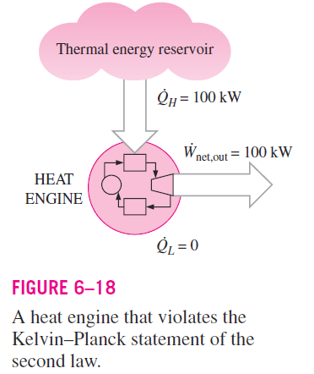
The Kelvin–Planck statement can also be expressed as no heat engine can have a thermal efficiency of 100 percent (Fig. 6–18), or as for a power plant to operate, the working fluid must exchange heat with the environment as well as the furnace.

Slide 38
REFRIGERATORS
We all know from experience that heat is transferred in the direction decreasing temperature, that is, from high-temperature mediums to low temperature ones.
This heat transfer process occurs in nature without requiring any devices.
The reverse process, however, cannot occur by itself.
The transfer of heat from a low-temperature medium to a high-temperature medium requires special devices called refrigerators.

Slide 39
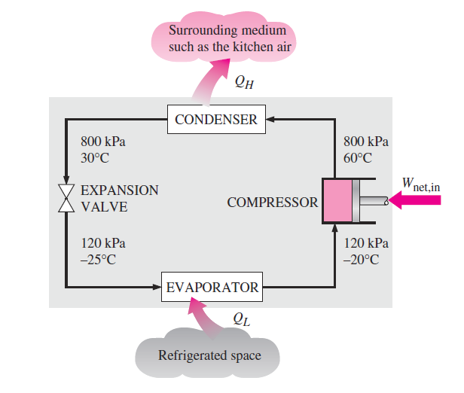
Refrigerators, like heat engines, are cyclic devices.
The working fluid used in the refrigeration cycle is called a refrigerant.
The most frequently used refrigeration cycle is the vapor-compression refrigeration cycle, which involves four main components: a compressor, a condenser, an expansion valve, and an evaporator, as shown in Fig. 6–19.

Slide 40
The refrigerant enters the compressor as a vapor and is compressed to the condenser pressure.
It leaves the compressor at a relatively high temperature and cools down and condenses as it flows through the coils of the condenser by rejecting heat to the surrounding medium.
It then enters a capillary tube where its pressure and temperature drop drastically due to the throttling effect.

Slide 41
The low-temperature refrigerant then enters the evaporator, where it evaporates by absorbing heat from the refrigerated space.
The cycle is completed as the refrigerant leaves the evaporator and re-enters the compressor.

Slide 42
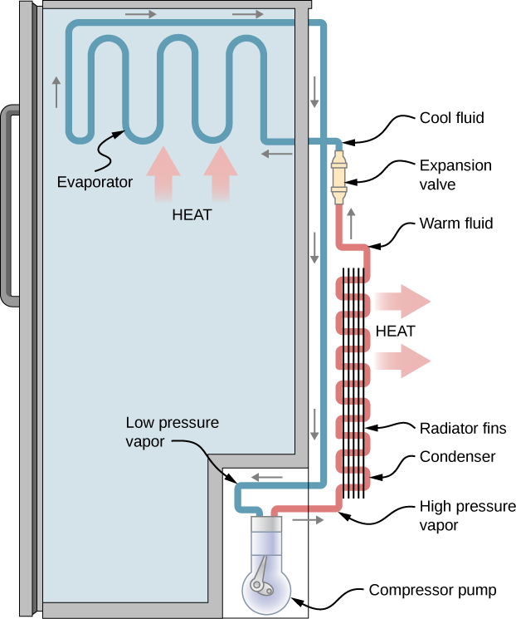
In a household refrigerator, the freezer compartment where heat is absorbed by the refrigerant serves as the evaporator,
The coils usually behind the refrigerator where heat is dissipated to the kitchen air serve as the condenser.

Slide 43
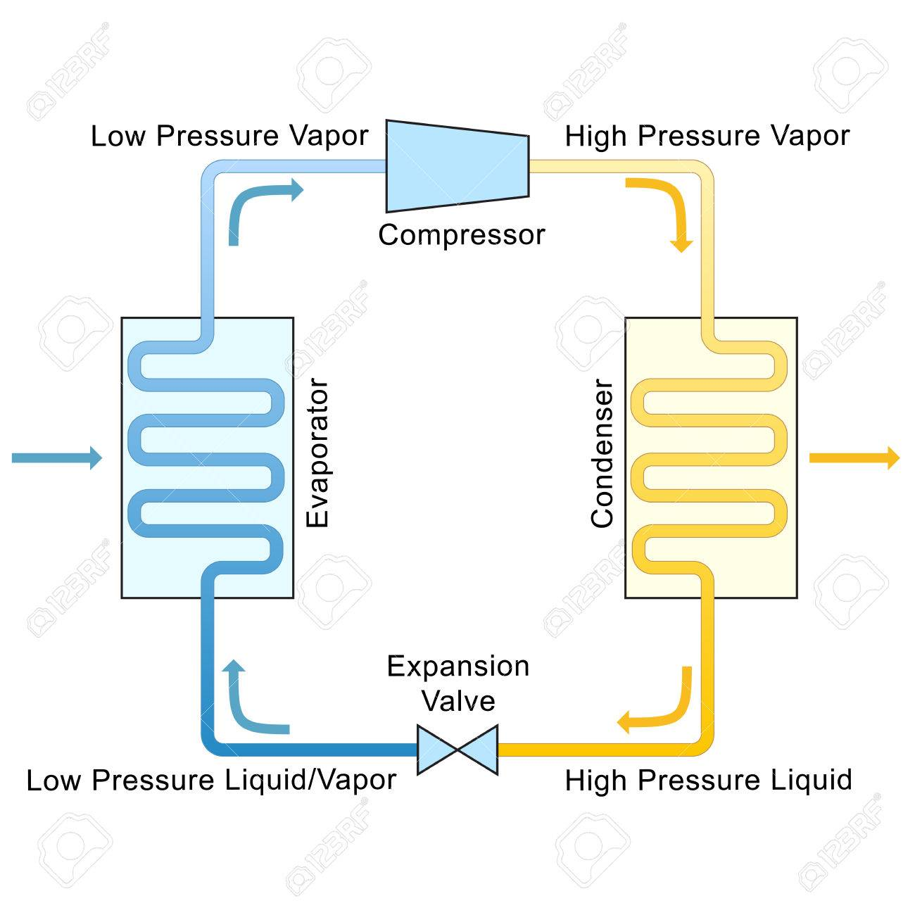

Slide 44
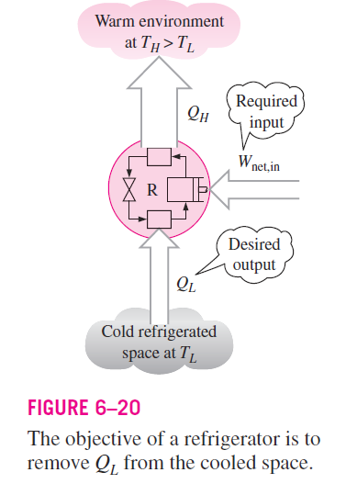
A refrigerator is shown schematically in Fig. 6–20.
Here Q_{L} is the magnitude of the heat removed from the refrigerated space at temperature T_{L},
Q_{H} is the magnitude of the heat rejected to the warm environment at temperature T_{H}
W_{net,in} is the net work input to the refrigerator.
As discussed before, Q_{L} and Q_{H} represent magnitudes and thus are positive quantities.

Slide 45

Coefficient of Performance
The efficiency of a refrigerator is expressed in terms of the coefficient of performance (COP), denoted by COP_{R}.
The objective of a refrigerator is to remove heat (Q_{L}) from the refrigerated space.
To accomplish this objective, it requires a work input of W_{net,in}.
Then the COP of a refrigerator can be expressed as

Slide 46
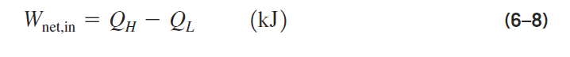

The conservation of energy principle for a cyclic device requires that
Then the COP relation becomes

Slide 47
Notice that the value of COP_{R} can be greater than unity.
That is, the amount of heat removed from the refrigerated space can be greater than the amount of work input.
This contrasts with the thermal efficiency, which can never be greater than 1.
In fact, one reason for expressing the efficiency of a refrigerator by another term—the coefficient of performance—is the desire to avoid the oddity of having efficiencies greater than unity.

Slide 48
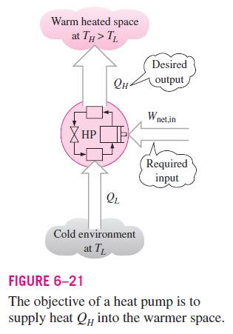
Heat Pumps
Another device that transfers heat from a low-temperature medium to a high-temperature one is the heat pump, shown schematically in Fig. 6–21
Refrigerators and heat pumps operate on the same cycle but differ in their objectives.
The objective of a refrigerator is to maintain the refrigerated space at a low temperature by removing heat from it.
Discharging this heat to a higher-temperature medium is a necessary part of the operation, not the purpose.

Slide 49
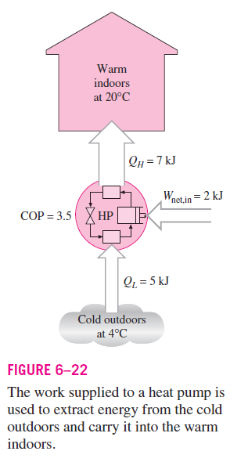
The objective of a heat pump, however, is to maintain heated space at a high temperature.
This is accomplished by absorbing heat from a low-temperature source, such as well water or cold outside air winter, and supplying this heat to the high-temperature medium such as a house (Fig. 6–22).
An ordinary refrigerator that is placed in the window of a house with its door open to the cold outside air in winter will function as a heat pump since it will try to cool the outside by absorbing heat from it and rejecting this heat into the house through the coils behind it (Fig. 6–23).

Slide 50
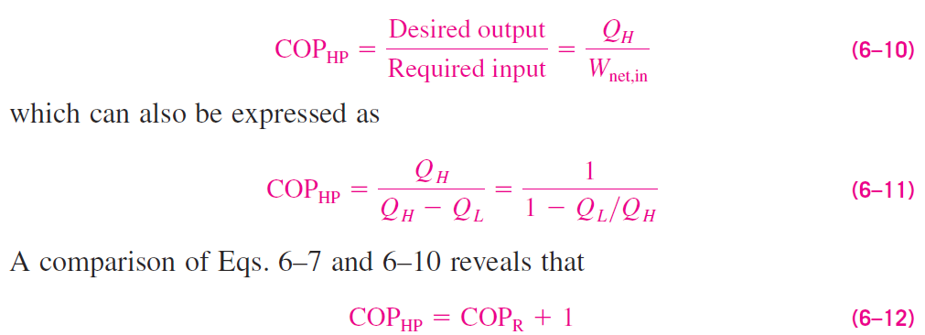
The measure of performance of a heat pump is also expressed in terms of the coefficient of performance COP_{HP}, defined as
This relation implies that the coefficient performance of a heat pump is always greater than unity since COP_{R} is a positive quantity.

Slide 51
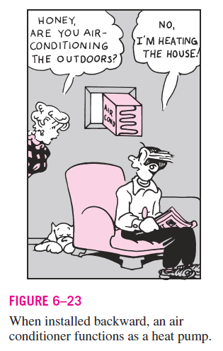
Air conditioners are basically refrigerators whose refrigerated space is
a room or a building instead of the food compartment.
A window air conditioning unit cools a room by absorbing heat from the room air and discharging it to the outside.
The same air-conditioning unit can be used as a heat pump in winter by installing it backwards
In this mode, the unit absorbs heat from the cold outside and delivers it to the room.
Air-conditioning systems that are equipped with proper controls and a reversing valve operate as air conditioners in summer and as heat pumps in winter.

Slide 52
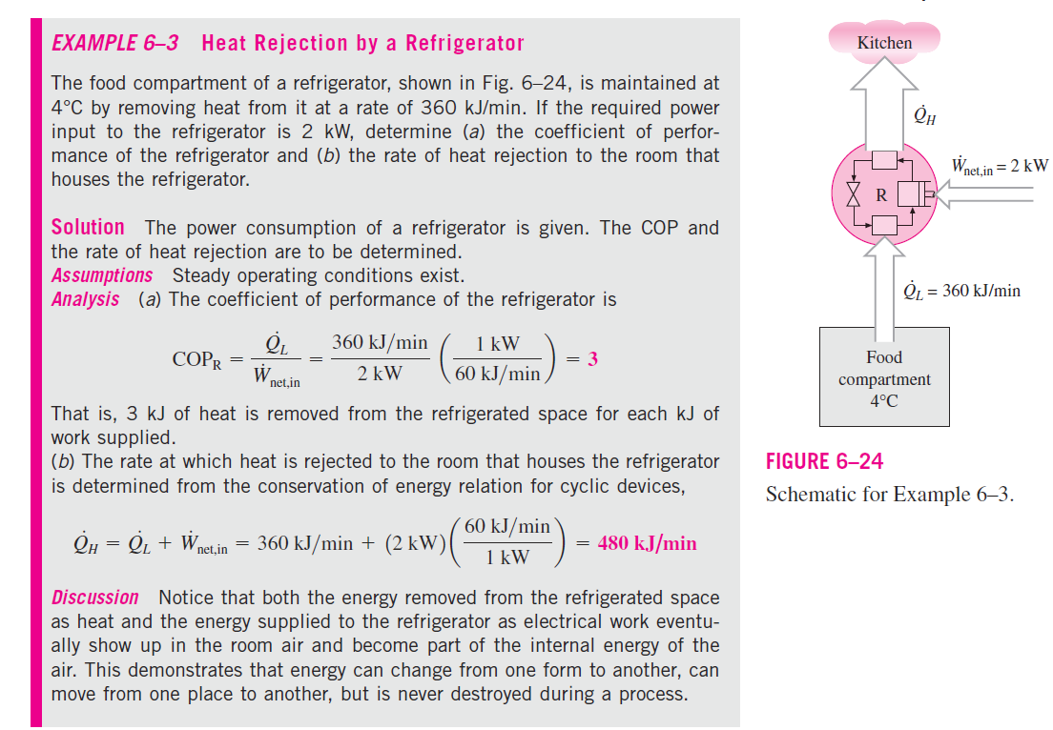

Slide 53
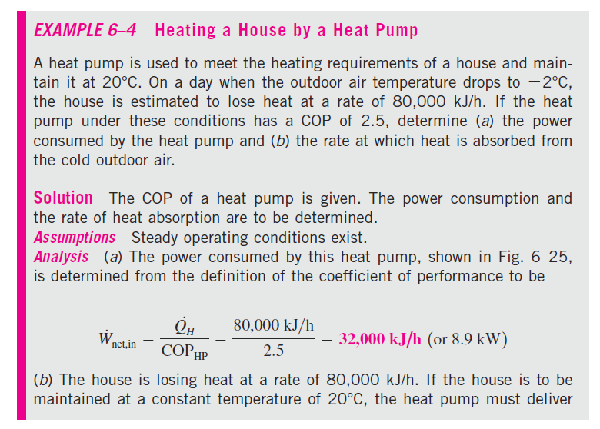
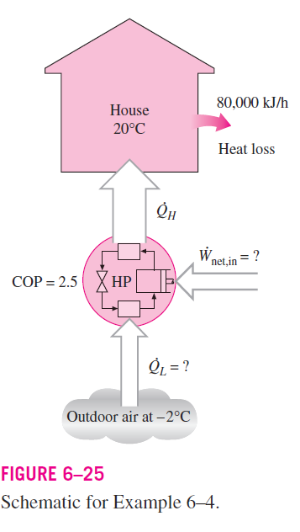

Slide 54
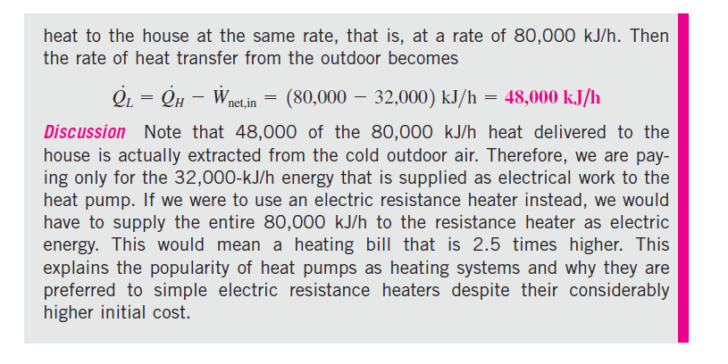

Slide 55
The Second Law of Thermodynamics: Clausius Statement
There are two classical statements of the second law—the Kelvin–Planck statement, which is related to heat engines and discussed in the preceding section, and the Clausius statement, which is related to refrigerators or heat pumps.
The Clausius statement is expressed as follows:
“It is impossible to construct a device that operates in a cycle and produces no effect other than the transfer of heat from a lower-temperature body to a higher-temperature body.”
It is common knowledge that heat does not, of its own, transfer from a cold medium to a warmer one.
The Clausius statement does not imply that a cyclic device that transfers heat from a cold medium to a warmer one is impossible to construct.
In fact, this is precisely what a common household refrigerator does.

Slide 56
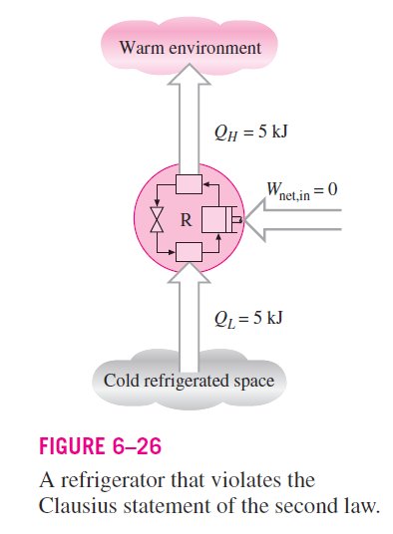
It simply states that a refrigerator cannot operate unless its compressor is driven by an external power source, such as an electric motor (Fig. 6–26).
The second law of thermodynamics is based on experimental observations. To date, no experiment has been conducted that contradicts the second law, and this should be taken as sufficient proof of its validity.

Slide 57
REVERSIBLE AND IRREVERSIBLE PROCESSES
The second law of thermodynamics states that no heat engine can have an efficiency of 100 percent. Then one may ask, What is the highest efficiency that a heat engine can possibly have? Before we can answer this question, we need to define an idealized process first, which is called the reversible process.
The processes that were discussed at the beginning of this chapter occurred in a certain direction. Once having taken place, these processes cannot reverse themselves spontaneously and restore the system to its initial state. For this reason, they are classified as irreversible processes.
Once a cup of hot coffee cools, it will not heat up by retrieving the heat it lost from the surroundings. If it could, the surroundings, as well as the system (coffee), would be restored to their original condition, and this would be a reversible process.

Slide 58
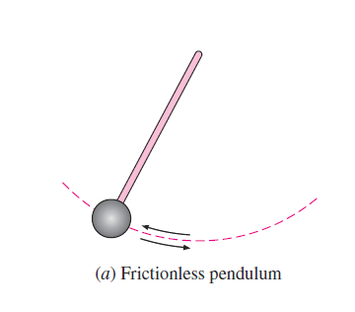
A reversible process is defined as a process that can be reversed without leaving any trace on the surroundings.
That is, both the system and the surroundings are returned to their initial states at the end of the reverse process.
Processes that are not reversible are called irreversible processes.
Reversible processes actually do not occur in nature. They are merely idealizations of actual processes.

Slide 59
THE CARNOT CYCLE
We mentioned earlier that heat engines are cyclic devices and that the working fluid of a heat engine returns to its initial state at the end of each cycle.
Work is done by the working fluid during one part of the cycle and on the working fluid during another part.
The difference between these two is the net work delivered by the heat engine.

Slide 60
The efficiency of a heat-engine cycle greatly depends on how the individual processes that make up the cycle are executed.
The net work, thus the cycle efficiency, can be maximized by using processes that require the least amount of work and deliver the most, that is, by using reversible processes.
Reversible cycles cannot be achieved in practice because the irreversibility associated with each process cannot be eliminated.
However, reversible cycles provide upper limits on the performance of real cycles.
Heat engines and refrigerators that work on reversible cycles serve as models to which actual heat engines and refrigerators can be compared.

Slide 61
Probably the best-known reversible cycle is the Carnot cycle, first proposed in 1824 by French engineer Sadi Carnot.
The theoretical heat engine that operates on the Carnot cycle is called the Carnot heat engine.
The Carnot cycle is composed of four reversible processes—two isothermal and two adiabatic—and it can be executed either in a closed or a steady-flow system.

Slide 62
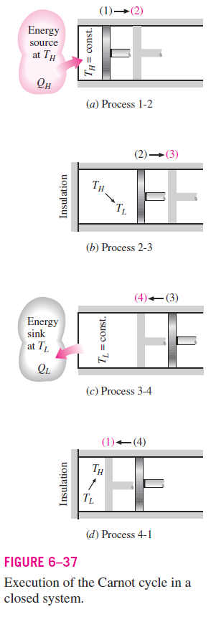
Consider a closed system that consists of a gas contained in an adiabatic piston–cylinder device, as shown in Fig. 6–37.
The insulation of the cylinder head is such that it may be removed to bring the cylinder into contact with reservoirs to provide heat transfer.
The four reversible processes that make up the Carnot cycle are as follows:

Slide 63
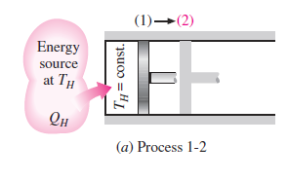
Reversible Isothermal Expansion
(process 1-2, T_{H} = constant)
Initially (state 1), the temperature of the gas is T_{H} and the cylinder head is in close contact with a source at temperature T_{H}.
The gas is allowed to expand slowly, doing work on the surroundings.
As the gas expands, the temperature of the gas tends to decrease.
But as soon as the temperature drops by an infinitesimal amount dT, some heat is transferred from the reservoir into the gas, raising the gas temperature to T_{H}.
Thus, the gas temperature is kept constant at T_{H}.
Since the temperature difference between the gas and the reservoir never exceeds a differential amount dT, this is a reversible heat transfer process.
It continues until the piston reaches position 2.
The amount of total heat transferred to the gas during this process is Q_{H}.

Slide 64
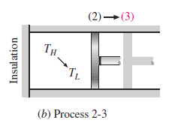
Reversible Adiabatic Expansion
(process 2-3, temperature drops from T_{H} to T_{L}).
At state 2, the reservoir that was in contact with the cylinder head is removed and replaced by insulation so that the system becomes adiabatic.
The gas continues to expand slowly, doing work on the surroundings until its temperature drops from T_{H} to T_{L}(state 3).
The piston is assumed to be frictionless and the process to be quasi equilibrium, so the process is reversible as well as adiabatic.

Slide 65

Reversible Isothermal Compression
(process 3-4, T_{L} = constant).
At state 3, the insulation at the cylinder head is removed, and the cylinder is brought into contact with a sink at temperature T_{L}.
Now the piston is pushed inward by an external force, doing work on the gas.
As the gas is compressed, its temperature tends to rise.
But as soon as it rises by an infinitesimal amount dT, heat is transferred from the gas to the sink, causing the gas temperature to drop to T_{L}.
Thus, the gas temperature remains constant at T_{L}.
Since the temperature difference between the gas and the sink never exceeds a differential amount dT, this is a reversible heat transfer process.
It continues until the piston reaches state 4.
The amount of heat rejected from the gas during this process is Q_{L}.

Slide 66

Reversible Adiabatic Compression
(process 4-1, temperature rises from T_{L} to T_{H}).
State 4 is such that when the low-temperature reservoir is removed, the insulation is put back on the cylinder head, and the gas is compressed in a reversible manner, the gas returns to its initial state (state 1).
The temperature rises from T_{L} to T_{H} during this reversible adiabatic compression process, which completes the cycle.

Slide 67

The P-V diagram of this cycle is shown in Fig. 6–38.
Remembering that on a P-V diagram the area under the process curve represents the boundary work for reversible processes,
we see that the area under curve 1-2-3 is the work done by the gas during the expansion part of the cycle, and the area under curve 3-4-1 is the work done on the gas during the compression part of the cycle.
The area enclosed by the path of the cycle (area 1-2-3-4-1) is the difference between these two and represents the net work done during the cycle.

Slide 68

The Reversed Carnot Cycle
The Carnot heat-engine cycle just described is a totally reversible cycle.
Therefore, all the processes that comprise it can be reversed, in which case it becomes the Carnot refrigeration cycle.
This time, the cycle remains exactly the same, except that the directions of any heat and work interactions are reversed:
Heat in the amount of Q_{L} is absorbed from the low-temperature reservoir, heat in the amount of Q_{H} is rejected to a high-temperature reservoir,
and a work input of W_{net,in} is required to accomplish all this.
The P-V diagram of the reversed Carnot cycle is the same as the one given for the Carnot cycle, except that the directions of the processes are reversed, as shown in Fig. 6–39.

Slide 69

THE CARNOT PRINCIPLES
The second law of thermodynamics puts limits on the operation of cyclic devices as expressed by the Kelvin–Planck and Clausius statements.
A heat engine cannot operate by exchanging heat with a single reservoir, and a refrigerator cannot operate without a net energy input from an external source.
We can draw valuable conclusions from these statements.0
Two conclusions related to the thermal efficiency of reversible and irreversible (i.e., actual) heat engines, and they are known as the Carnot principles (Fig. 6–40), expressed as follows:
The efficiency of an irreversible heat engine is always less than the efficiency of a reversible one operating between the same two reservoirs.
The efficiencies of all reversible heat engines operating between the same two reservoirs are the same.

Slide 70



THE CARNOT HEAT ENGINE
The hypothetical heat engine that operates on the reversible Carnot cycle is called the Carnot heat engine.
The thermal efficiency of any heat engine, reversible or irreversible, is given by
Where Q_{H} is heat transferred to the heat engine from a high-temperature reservoir at T_{H}, and Q_{L} is heat rejected to a low-temperature reservoir at T_{L}.
For reversible heat engines, the heat transfer ratio in the above relation can be replaced by the ratio of the absolute temperatures of the two reservoirs as given by Eq. 6–16.
Then the efficiency of a Carnot engine, or any reversible heat engine, becomes

Slide 71

This relation is often referred to as the Carnot efficiency, since the Carnot heat engine is the best known reversible engine.
This is the highest efficiency a heat engine operating between the two thermal energy reservoirs at temperatures T_{L} and T_{H} can have (Fig. 6–46).
All irreversible (i.e., actual) heat engines operating between these temperature limits (T_{L} and T_{H}) have lower efficiencies.
An actual heat engine cannot reach this maximum theoretical efficiency value because it is impossible to completely eliminate all the irreversibilities associated with the actual cycle.
Note that T_{L} and T_{H} in Eq. 6–18 are absolute temperatures. Using °C or °F for temperatures in this relation gives results grossly in error.

Slide 72



The thermal efficiencies of actual and reversible heat engines operating between the same temperature limits compare as follows (Fig. 6–47):
Most work-producing devices (heat engines) in operation today have efficiencies under 40 percent, which appear low relative to 100 percent.
However, when the performance of actual heat engines is assessed, the efficiencies should not be compared to 100 percent; instead, they should be compared to the efficiency of a reversible heat engine operating between the same temperature limits—because this is the true theoretical upper limit for the efficiency, not 100 percent.

Slide 73
The maximum efficiency of a steam power plant operating between T_{H} 1000 K and T_{L} 300 K is 70 percent, as determined from Eq. 6–18.
Compared with this value, an actual efficiency of 40 percent does not seem so bad, even though there is still plenty of room for improvement.
It is obvious from Eq. 6–18 that the efficiency of a Carnot heat engine increases as T_{H} is increased, or as T_{L} is decreased.
This is to be expected since as T_{L} decreases, so does the amount of heat rejected, and as T_{L} approaches zero, the Carnot efficiency approaches unity.

Slide 74
The thermal efficiency of actual heat engines can be maximized by supplying heat to the engine at the highest possible temperature (limited by material strength) and rejecting heat from the engine at the lowest possible temperature (limited by the temperature of the cooling medium such as rivers, lakes, or the atmosphere).

Slide 75




Slide 76

The Quality of Energy
The Carnot heat engine in Example 6–5 receives heat from a source at 925 K and converts 67.2 percent of it to work while rejecting the rest (32.8 percent) to a sink at 303 K.
Now let us examine how the thermal efficiency varies with the source temperature when the sink temperature is held constant.
The thermal efficiency of a Carnot heat engine that rejects heat to a sink at 303 K is evaluated at various source temperatures using Eq. 6–18 and is listed in Fig. 6–49.
Clearly the thermal efficiency decreases as the source temperature is lowered.
When heat is supplied to the heat engine at 500 instead of 925 K, for example, the thermal efficiency drops from 67.2 to 39.4 percent.

Slide 77

These efficiency values show that energy has quality as well as quantity.
It is clear from the thermal efficiency values in Fig. 6–49 that more of the high-temperature thermal energy can be converted to work.
Therefore, the higher the temperature, the higher the quality of the energy (Fig. 6–50).

Slide 78
Large quantities of solar energy, for example, can be stored in large bodies of water called solar ponds at about 350 K.
This stored energy can then be supplied to a heat engine to produce work (electricity).
However, the efficiency of solar pond power plants is very low (under 5 percent) because of the low quality of the energy stored in the source, and the construction and maintenance costs are relatively high.
Therefore, they are not competitive even though the energy supply of such plants is free. The temperature (and thus the quality) of the solar energy stored could be raised by utilizing concentrating collectors, but the equipment cost in that case becomes very high.
Work is a more valuable form of energy than heat since 100 percent of work can be converted to heat, but only a fraction of heat can be converted to work.
When heat is transferred from a high-temperature body to a lower temperature one, it is degraded since less of it now can be converted to work.
For example, if 100 kJ of heat is transferred from a body at 1000 K to a body at 300 K, at the end we will have 100 kJ of thermal energy stored at 300 K, which has no practical value.
But if this conversion is made through a heat engine, up to 1 - 300/1000 = 70 percent of it could be converted to work, which is a more valuable form of energy.
Thus 70 kJ of work potential is wasted as a result of this heat transfer, and energy is degraded.

Slide 79

THE CARNOT REFRIGERATOR AND HEAT PUMP
A refrigerator or a heat pump that operates on the reversed Carnot cycle is called a Carnot refrigerator, or a Carnot heat pump.
The coefficient of performance of any refrigerator or heat pump, reversible or irreversible, is given by Eqs. 6–9 and 6–11 as
Where Q_{L} is the amount of heat absorbed from the low-temperature medium and Q_{H} is the amount of heat rejected to the high-temperature medium.
The COPs of all reversible refrigerators or heat pumps can be determined by replacing the heat transfer ratios in the above relations by the ratios of the absolute temperatures of the high- and low-temperature reservoirs,

Slide 80



Then the COP relations for reversible refrigerators and heat pumps become
These are the highest coefficients of performance that a refrigerator or a heat pump operating between the temperature limits of T_{L} and T_{H} can have.
All actual refrigerators or heat pumps operating between these temperature limits (T_{L} and T_{H}) have lower coefficients of performance (Fig. 6–51).

Slide 81

The coefficients of performance of actual and reversible refrigerators operating between the same temperature limits can be compared as follows:
A similar relation can be obtained for heat pumps by replacing all COPR’s in Eq. 6–22 by COP_{HP}.
The COP of a reversible refrigerator or heat pump is the maximum theoretical value for the specified temperature limits.
Actual refrigerators or heat pumps may approach these values as their designs are improved, but they can never reach them.

Slide 82



Slide 83




